Slide 1
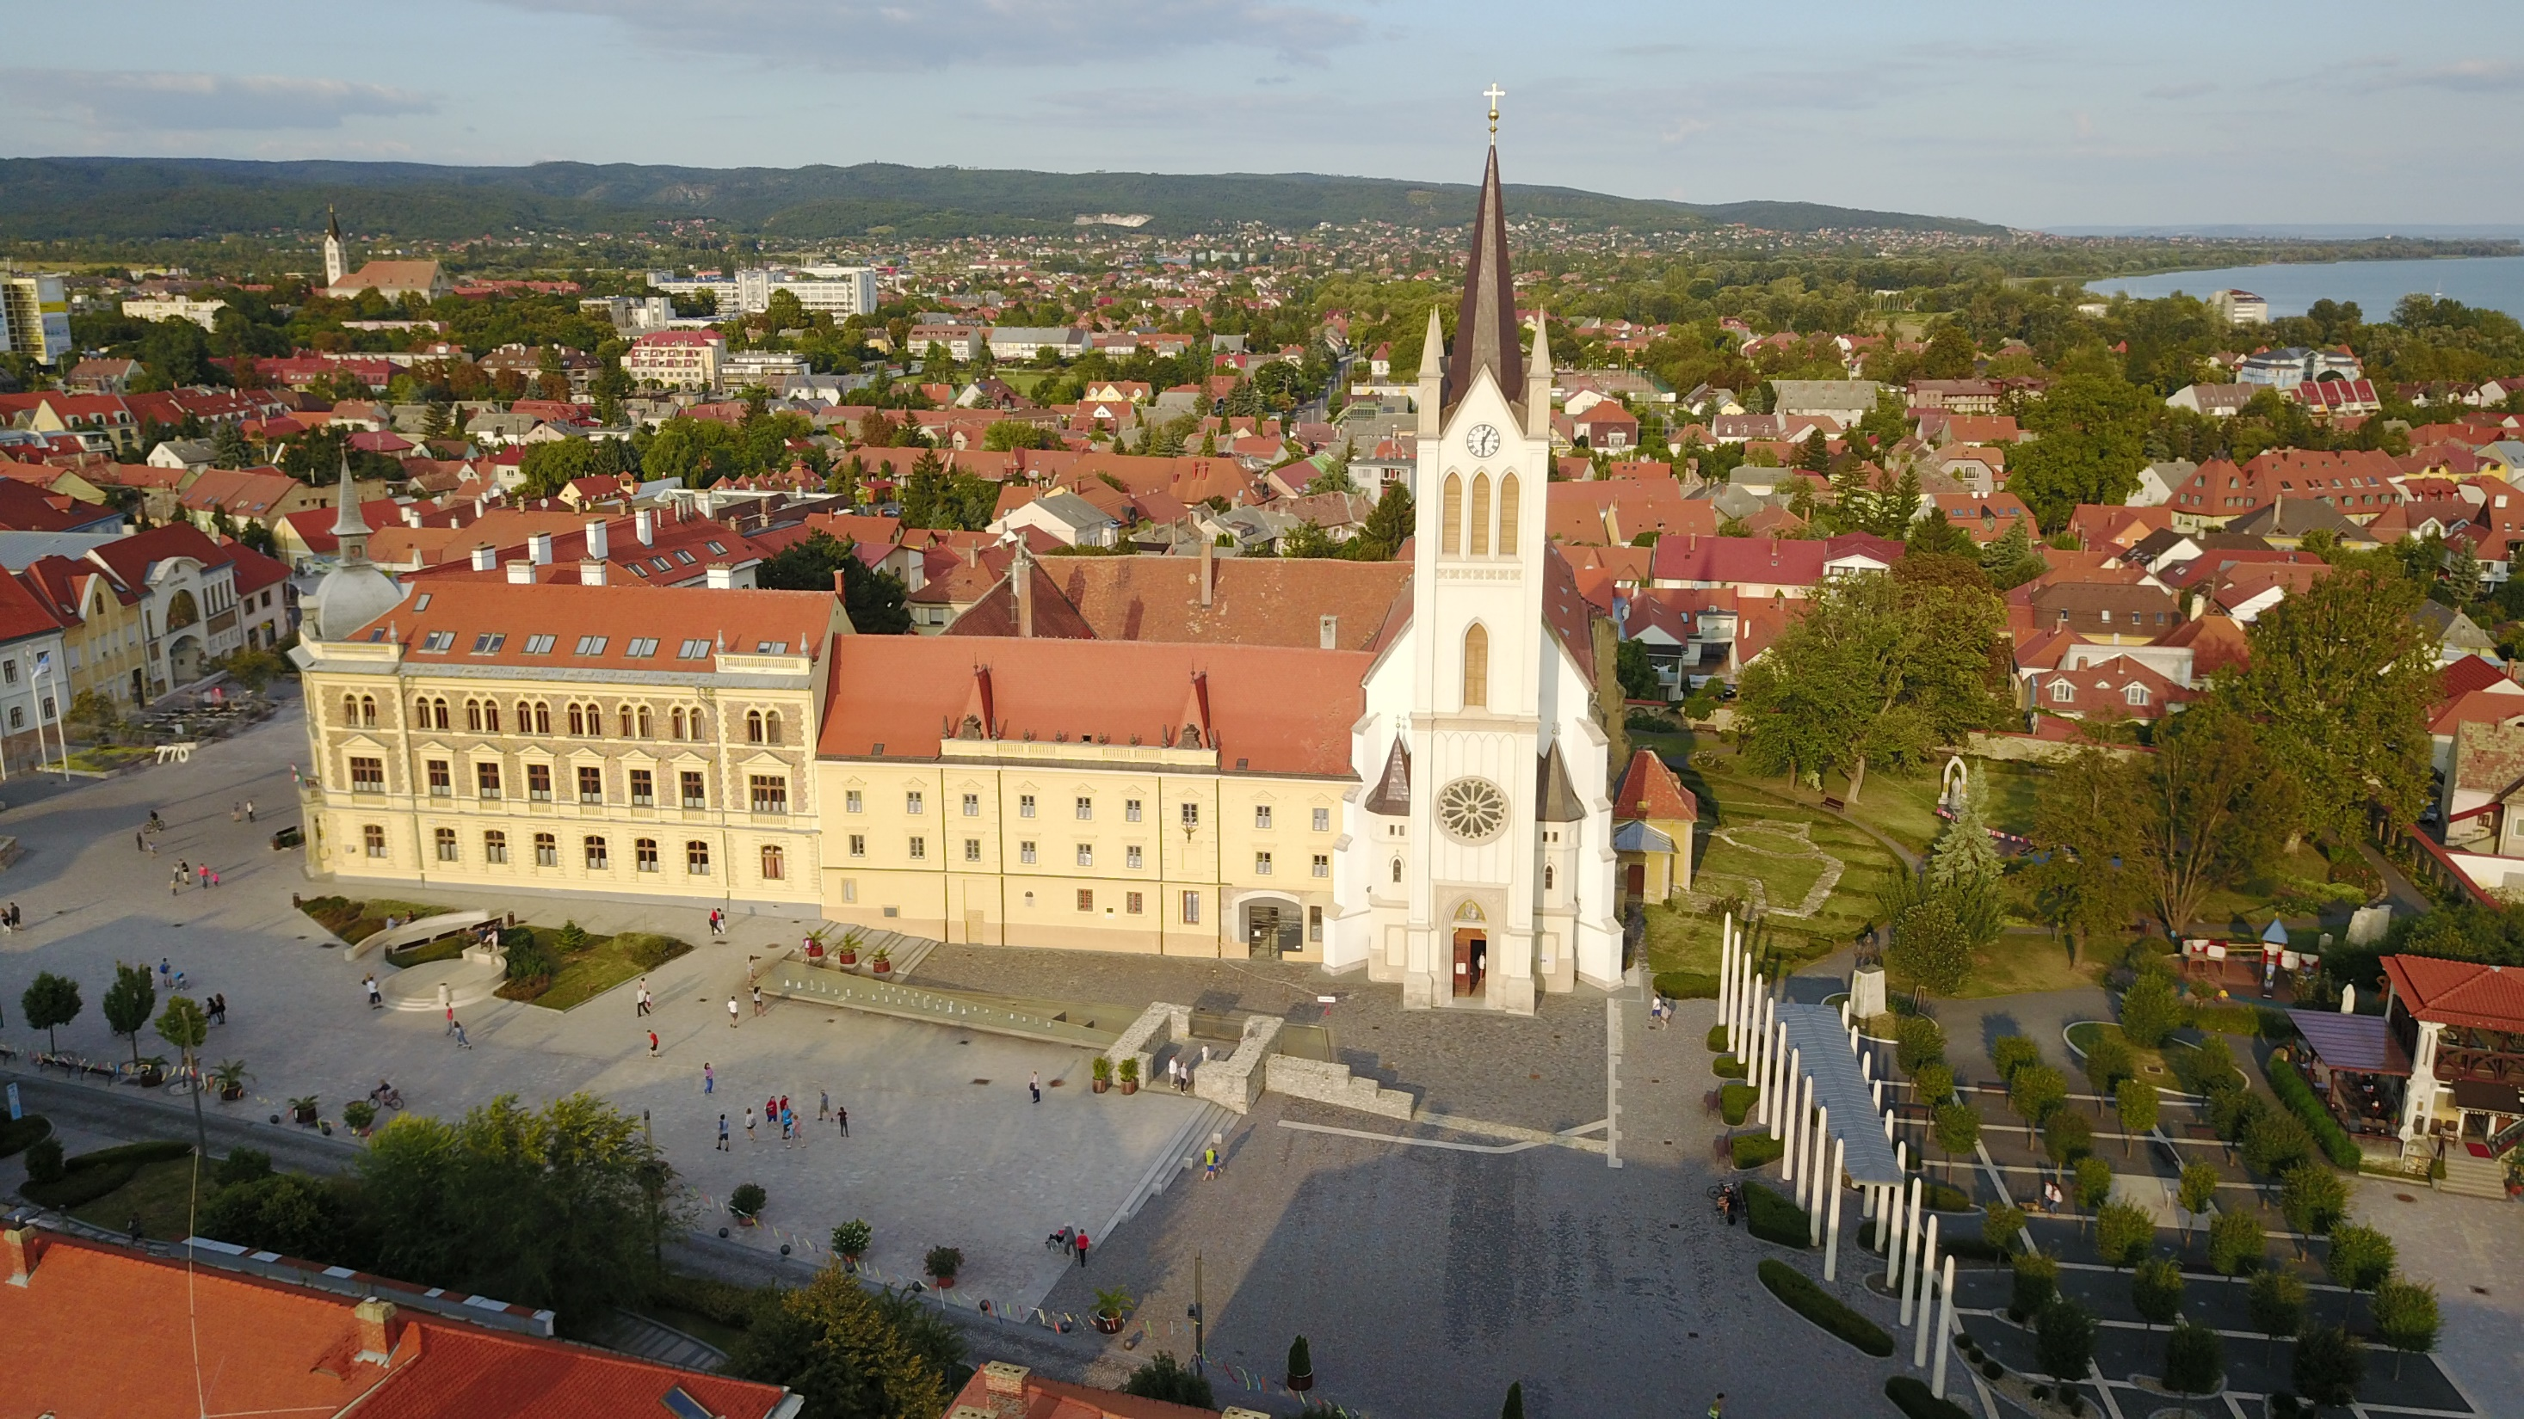
PREMONSTRATENSIAN VOCATIONAL GRAMMARSCHOOL, TECHNICAL SCHOOL AND DORMITORY
Keszthely

Slide 2
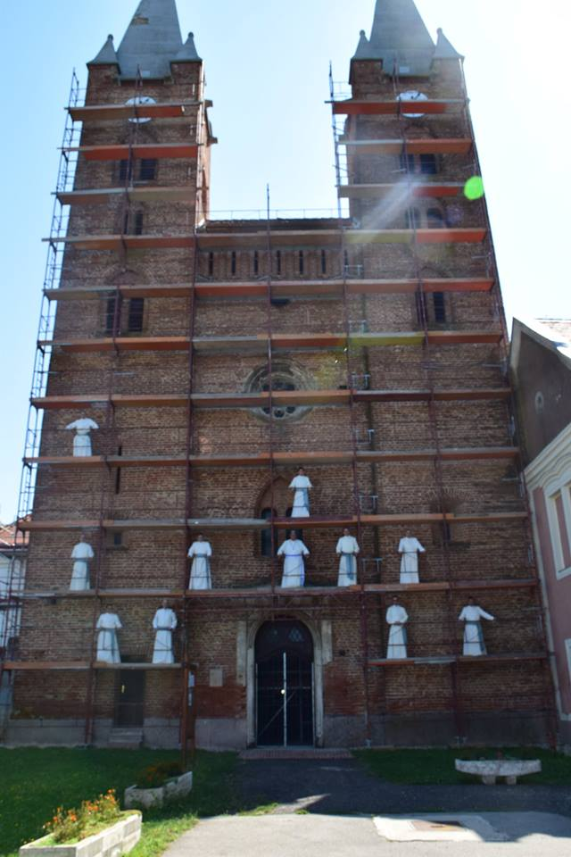
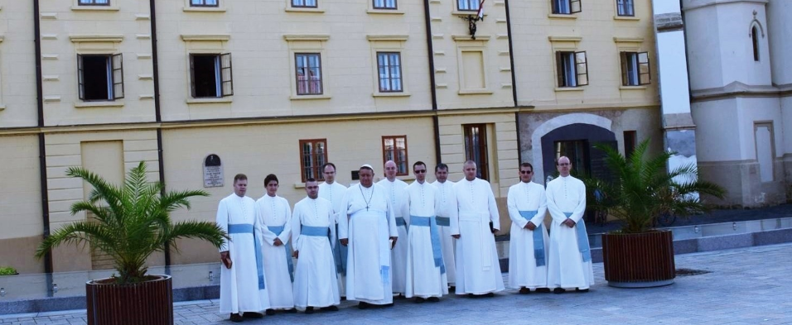
Funding/controlling body
Norbertine Abbey of Csorna
Notes:
lllll

Slide 3
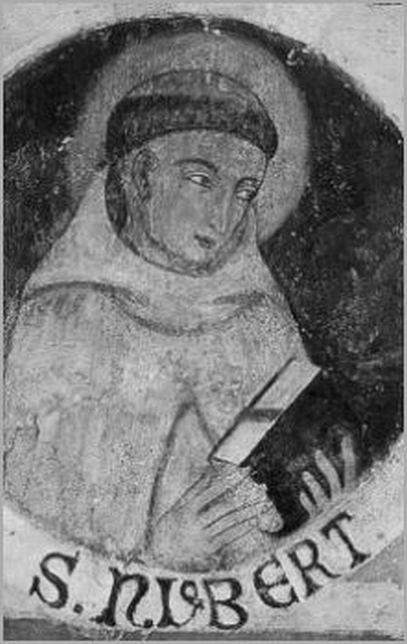
Education
'Prepared for every good work'.
(„AD OMNE OPUS BONUM PARATI”)
We not only teach students but also put an emphasis on education and morals. The key values are reliability and the acceptance of universal human values.

Slide 4
Training routes in Hungary
secondary grammar school
Vocational grammar school
4+1 yrs
(9-12th. + 13th )
MATURA (ordinary or advanced level)
5/13 grade
Technical school
Higher education
Prima-ry school 8th grade
Technical school
5 yrs
(9-13th)
VOCATIONAL TECHNICAL EXAM + ordinary / advanced level MATURA
Labour market
Vocational school

Slide 5
Our school
Vocational grammar school AND technical school
Relaitively new, has been operating in this form since 2017
Small, with a family atmosphere
200 students, specialized in 3 fields
19 full time + 9 part-time teachers

Slide 6
Premontrei, Keszthely
(video)

Slide 7
Why us?
Our vocational trainings are held by professionals, colleagues from the field
Marketable professions, good salaries
Practice-based lessons
Effective education, small groups
Study-on opportunities
Stately provided scholarship

Slide 8
'Extras' on top of matura and the professional exam
3-week professional trainings abroad (Erasmus+: Milan, Barcelona, Várna, Kassa)
Foreign language courses abroad (Tempus)
Preparation for intermediate / upper-intermediate language exams
ECDL courses and exam (not only for students of IT)
Participation in academic competitions

Slide 9
'Extras'
Innovative and open-minded teacher community
International co-operation:
REACTI-VET: Teachers for Reactive and Responsive Vocational Education
The successful cooperation with the program coordinator and the experience gained will help us in tjis new project. (Erasmus+ KA2, strategic partnership, 4 participating countries: HU, IT, UK, EE)
Teacher experience in national curriculum- development, course material development programs (IT, healthcare, other professional fields)
Short-term aim: to become a national talent point

Slide 10
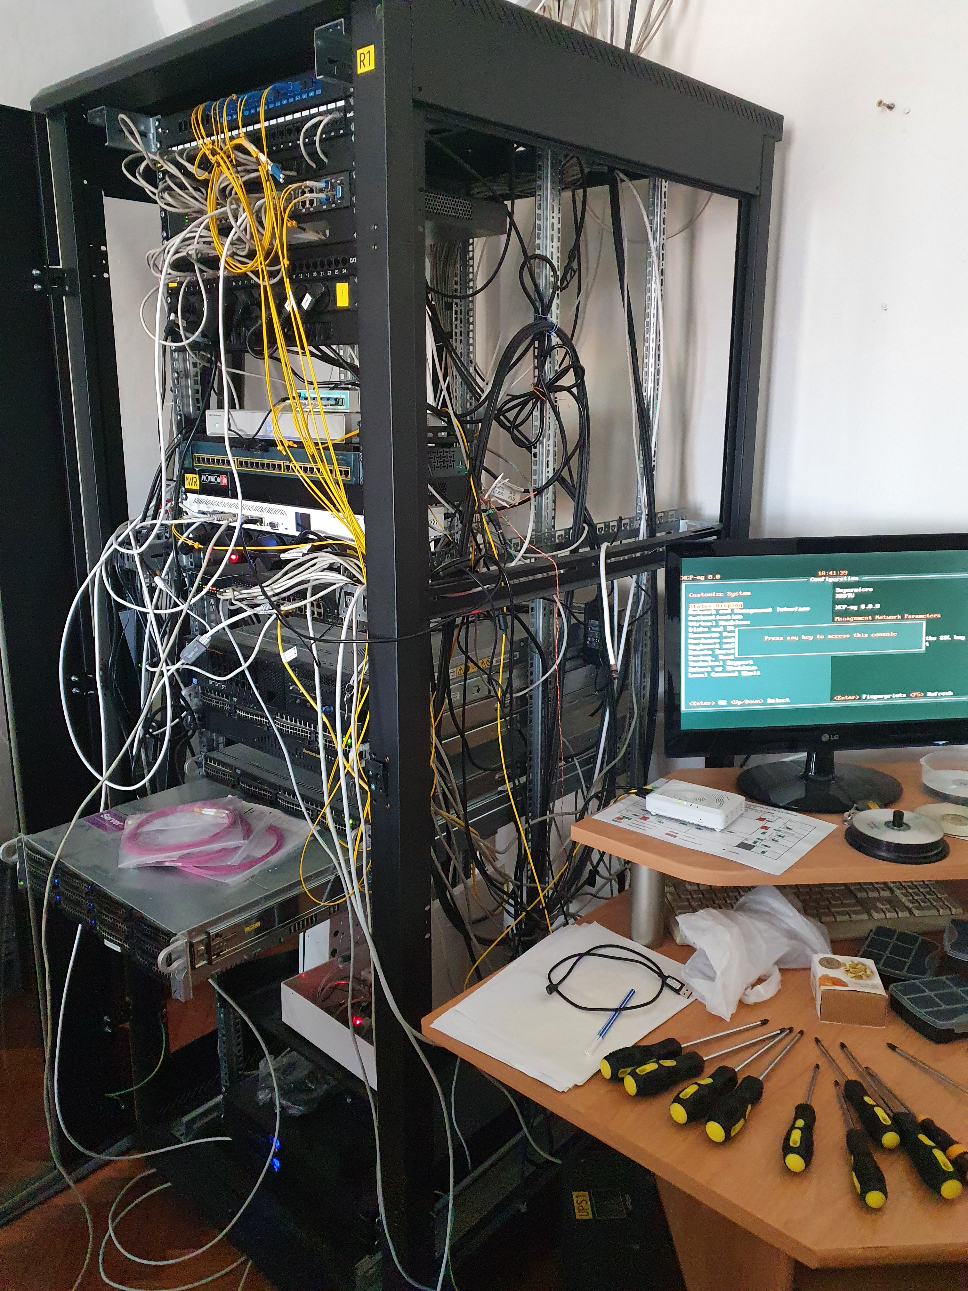
IT - infrastructure
Infrastructure
RAM: 2x64GB
µP: 2x48 mag
HDD: 10 TB
Internet: 1 Gb/s
Computer labs: 2
Wifi (full coverage)
Virtual Learning Environment (Moodle)

Slide 11
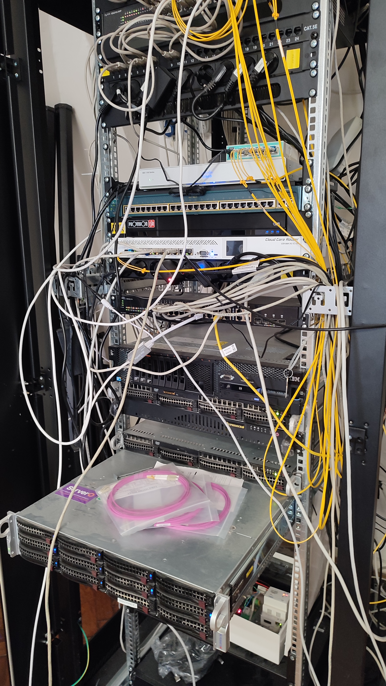
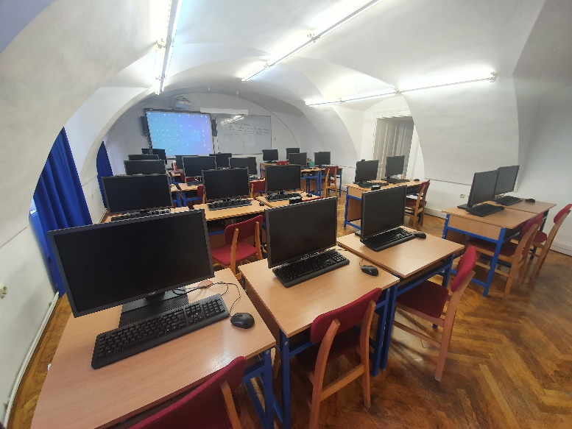
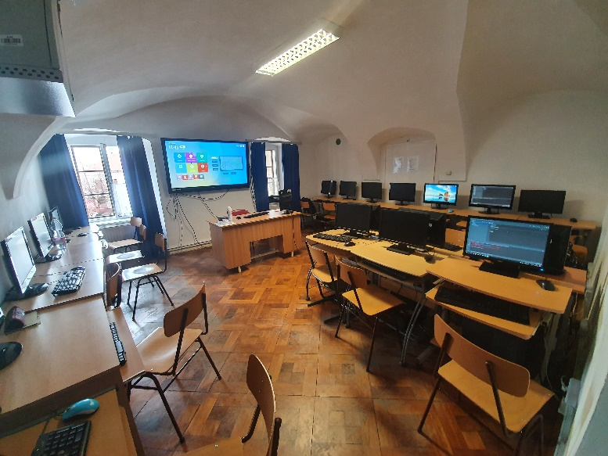
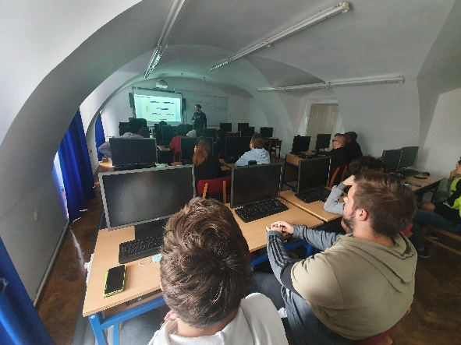
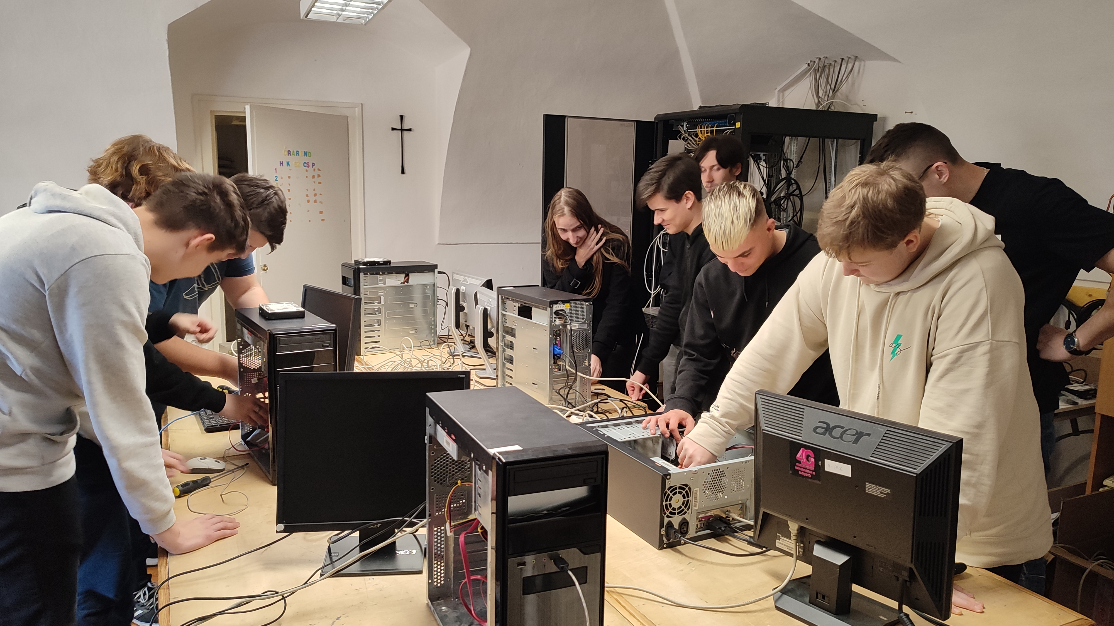
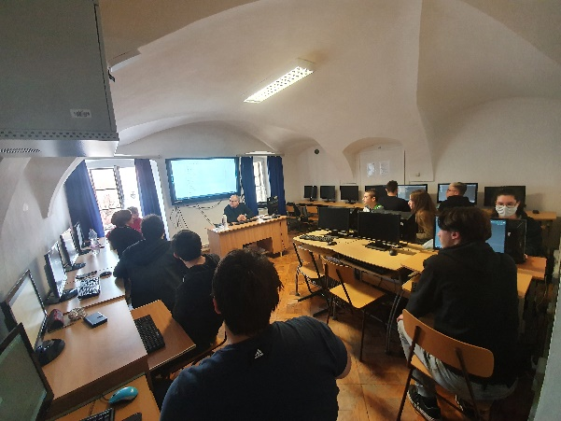
IT – infrastructure / Computer labs

Slide 12
IT – human resources
IT teachers
Full-time: 4
Part-time: 2
Key areas
Programming
Network
Web development
Graphics
Media
Professional partners
CISCO Networking Academy
John von Neumann Computer Society
Z-WARE Informatics Ltd
Mikroháló Ltd
Bábelhal Webstudió Ltd
TC Informatics Ltd
Notes:
Teachers: professionals, with entrepreneur background = practical knowledge and skills besides methodology. Experience in materials development projects- distant-learning tutors (Csaba, Agnes), expertise in modern methodologies.

Slide 13
Moodle

Slide 14
http://premontrei-keszthely.hu

Slide 15
Facebook

Slide 16
Thank you for your attention!
http://premontrei-keszthely.hu

