Slide 1
Welcome!
Notes:
1

Slide 2
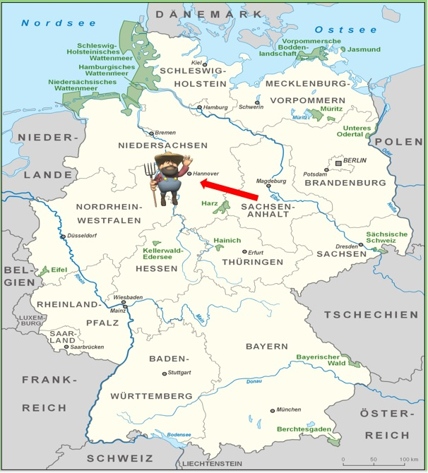
Location
Country:
Germany
Federal Land:
Niedersachsen
(Lower Saxony)
City:
Nienburg(Weser)
2

Slide 3
Founded 1027
Since 1992 g GMBH
90 members of staff
10.000 participants per year
240 cooperation companies
25 partner countries
250 seminars
9000 m² total area
2 comfortable guesthouses
20 years of international experience
3

Slide 4
DEULA - Nienburg Ltd.
Shareholders
Chamber of Agriculture of Lower Saxony 60 %
Nienburg District
25 %
GaLaBau 15%
4
Notes:
4

Slide 5
5

Slide 6
6

Slide 7
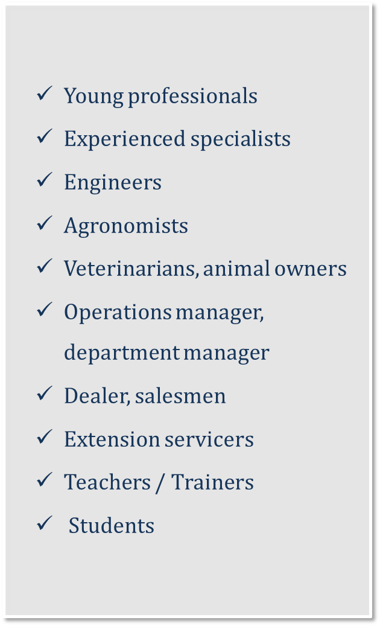
For whom?
7

Slide 8
Why do we participate in this project ?
https://e-learning.deula-nienburg.de/ilias.php?sc2Page=9&sc2ctrl=SimpleCms2__Module__Core__Controller__PageController&sc2action=show&cmdClass=ilsimplecms2routinggui&cmdNode=n8:x0&baseClass=ilobjplugindispatchgui
8

Slide 9
https://data.deula-nienburg.de/deula.mp4
9

Slide 10
Thank you for your attention
Notes:
10

